Slide 1
Week 10-11

Slide 2
Things to do
Add display image and IoT data in exist frontend.
Add sorting or filtering
Estimate more (graph)
Future plan(Expandability)
Link dataset with Ai model
Get information of dataset
How do we update:
Once there are update in backend, announce frontend
Frontend access backend, ask backend whether there are update

Slide 3
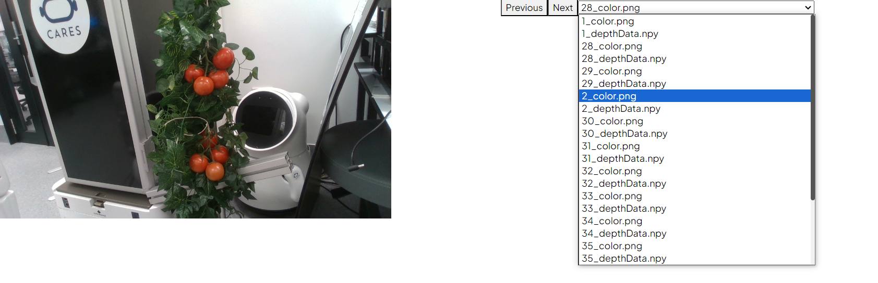
Display MySQL data and captured image
Add new tab in the exist frontend and add new function that can see IoT data and captured image
User can select the image what they want to see.

Slide 4
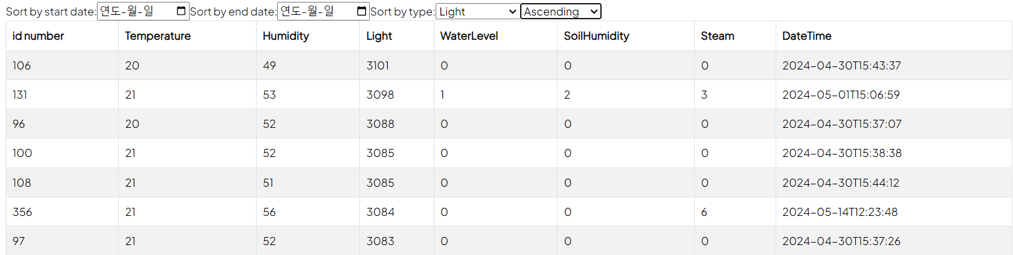
Data Sorting and filtering
IoT data is displayed in ascending and descending order for each item.

Slide 5
Announced All Client Updates
 | Polling | Server Socket Event (SSE) | WebSockets
Request method | HTTP | HTTP | TCP long connection
Trigger mode | Polling | Event | Event
Advantage | Simple and easy to implement | Simple implementation and low development cost | Full-duplex communication, low overhead, secure and scalable
Disadvantage | Consumption is large | Not compatible with IE | Transmitting data requires secondary analysis, which results in high development costs.

Slide 6
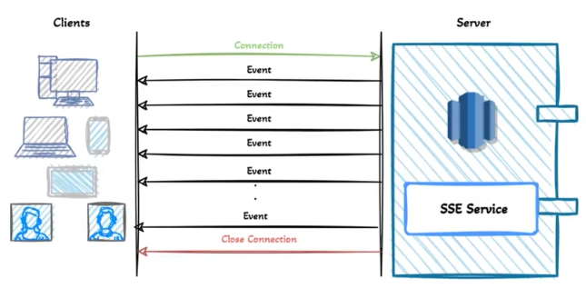
Adding SSE to Flask
Install flask sse: pip install flask-sse
In server py file:
Create global variable list to store all clients connect to server
Create global variable store the latest file
Create function for server and client
Client: Subscribe server
Server: Store client using queue
Server: Notify client the filename when new file update to server

Slide 7
Feedback
Websocket are prefer for future development.
Ready for get data from real farm(IoT data ) and image (Realsense)
Aim to develop application on different device form a large network use the AI server, by taking picture and send to server, process the image and return result.

